Slide 1
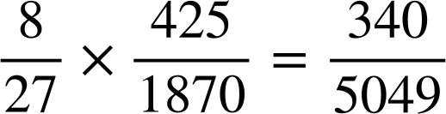
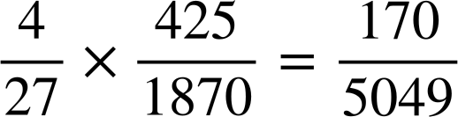
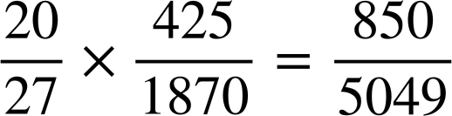
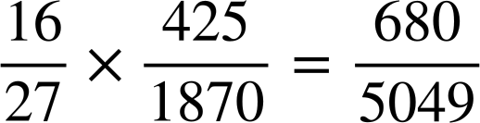
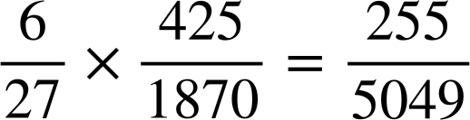
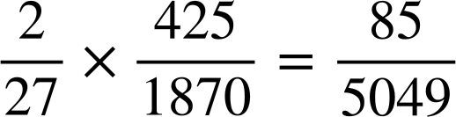
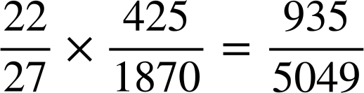
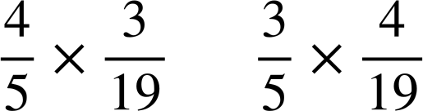
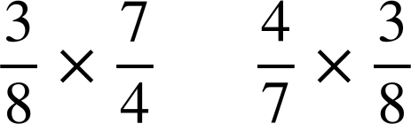
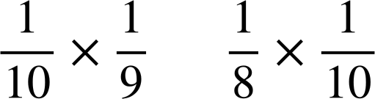
Securing understanding of multiplication with fractions
Task A: Comparing products
1) Use this fact to answer the following questions:
a)
b)
c)
d)
e)
f)
2) Without calculating, decide which is the greater product in each pair.
a)
b)
c)
d) Write the six products in order from smallest to largest.
=
>
<
=

Slide 2
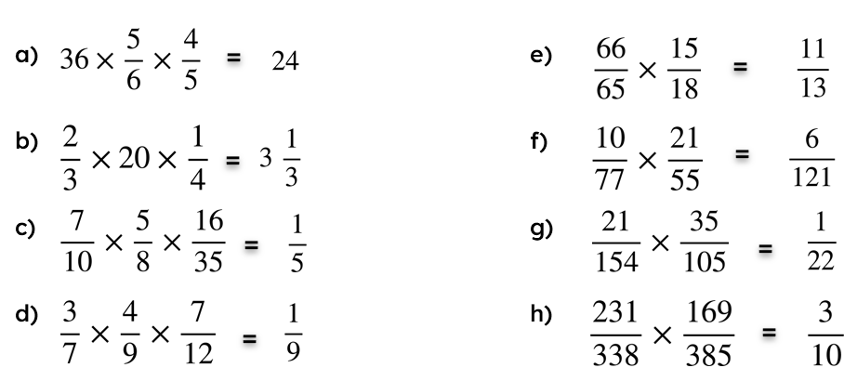
Securing understanding of multiplication with fractions
Task B: Multiplying two or more fractions
1) Use the most efficient method to answer these questions.
Mathematics in Education and Industry
v2.2

